Slide 1


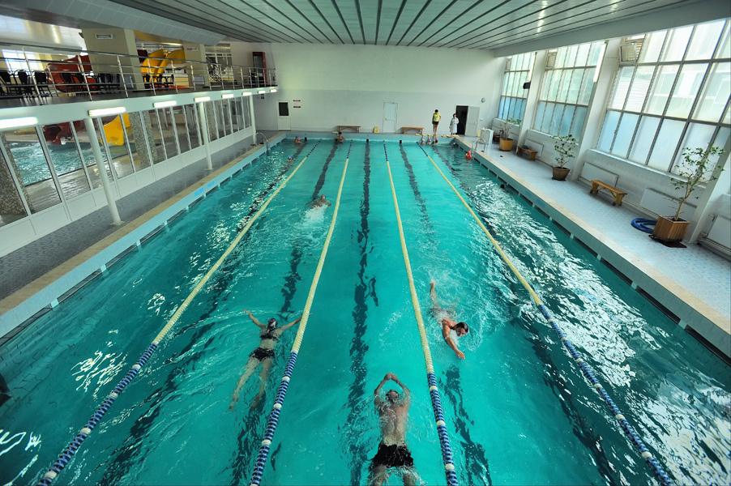
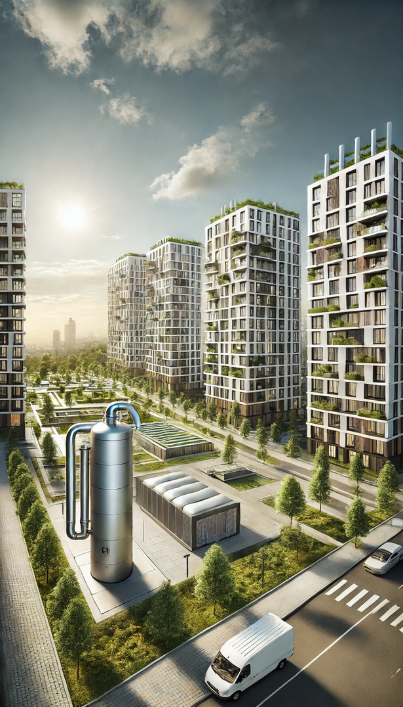



Reconstruction project of the “Mytnytsia” microdistrict with the installation of heat pumps with a storage tank

Slide 2

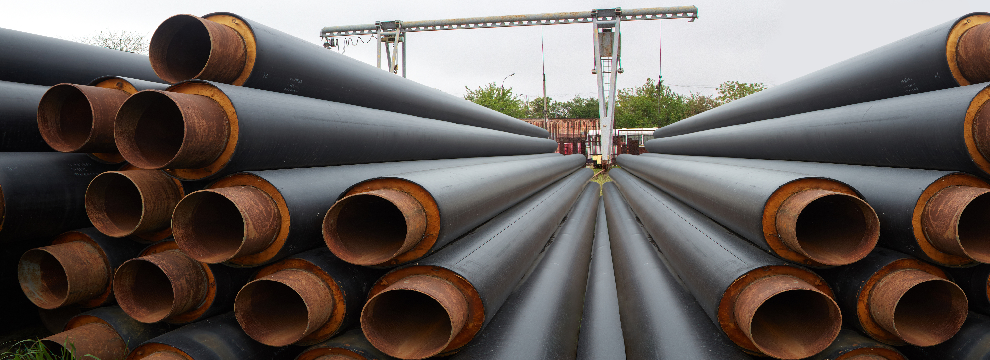
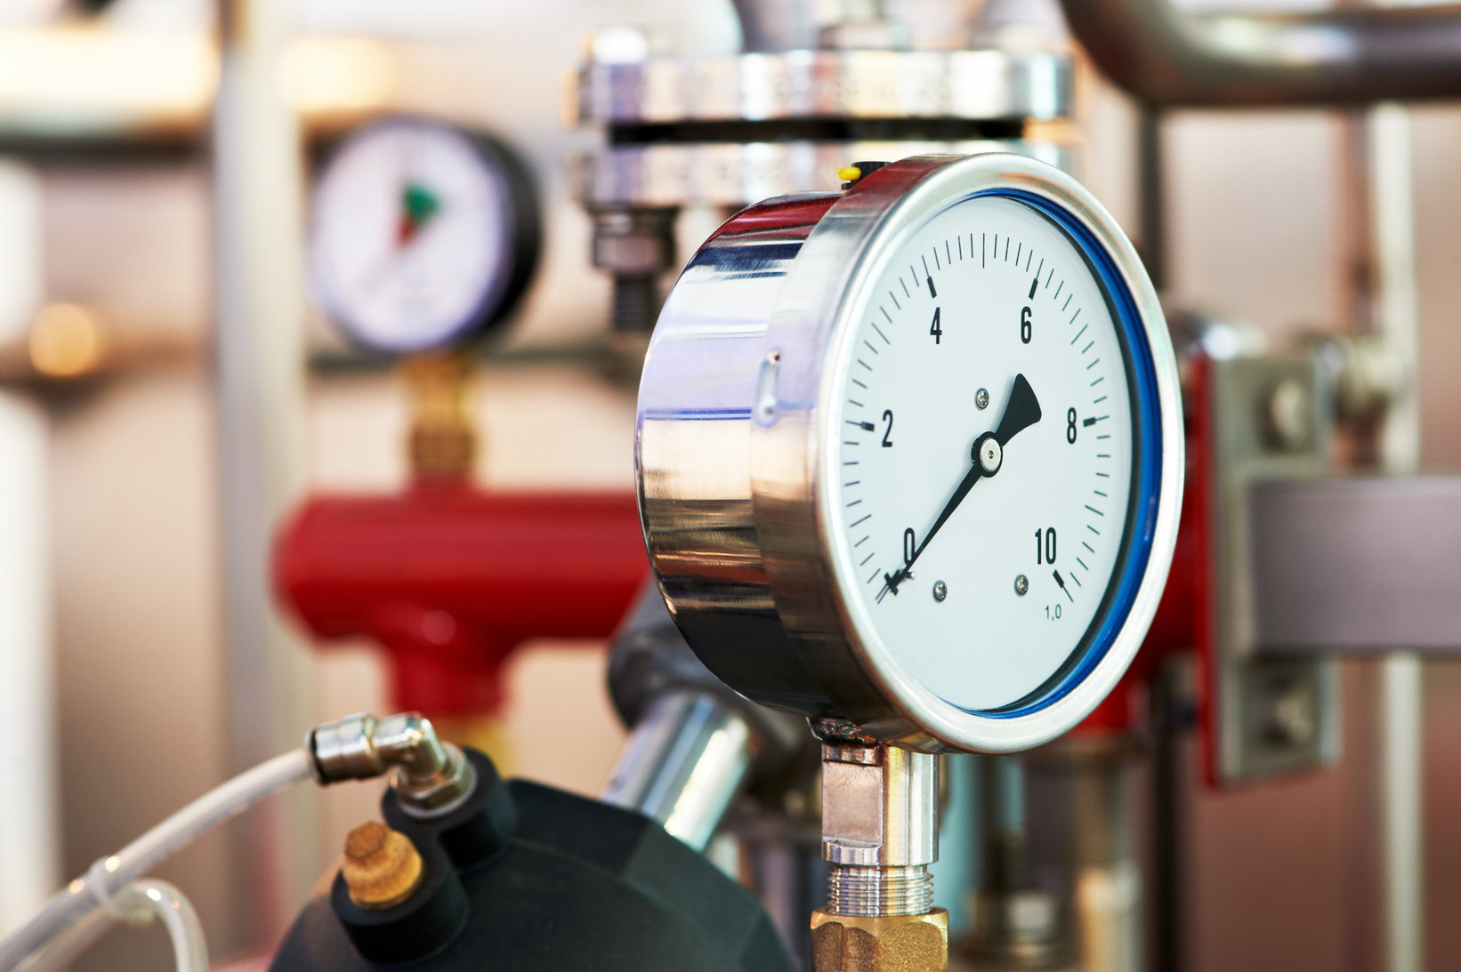





Reconstruction project of the “Mytnytsia” microdistrict with the installation of heat pumps with a storage tank
The project includes the following works:
purchase of equipment
installation of equipment
commissioning
thermal capacity of two heat pumps : 8 MW
The total cost of the project is
≈ 4 100 000 €

